Slide 1
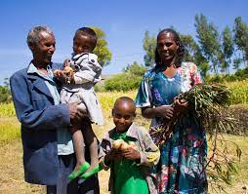
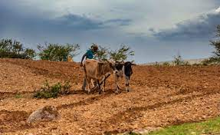
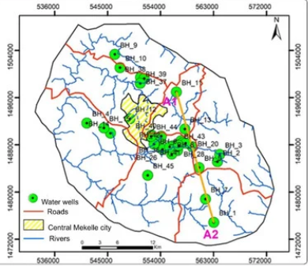
Site selection criteria for the Raya irrigation farming project should consider various factors to ensure the success and sustainability of the project.
Farmer:
Family size
Willingness
Financial status
Farmland:
Land size
Land use (suitable for Irrigation)
Distance from water source
Water volume needed
Water Source:
Location
Water level
Use condition
Ownership
Access (permit)
Gather the information above (add more if needed). Select a farmland and family for the pilot program that meet the selection criteria. Select a farmland that is owned by a farmer family with financial stress, with farm that is suitable for irrigation farming and close to a water source that have enough water for farming with permission to use. Consider the energy required to move the water from the water source to the farmland.

Slide 2
Site selection criteria for the Raya irrigation farming project should consider various factors to ensure the success and sustainability of the project. Here's a comprehensive list of criteria:
Farmers' Financial Situation:
Determining the financial inability of farmers to afford irrigation projects without external assistance involves a thorough assessment of their financial capacity and resources. Here are the key steps and considerations:
Financial Analysis:
Conduct a comprehensive financial analysis of individual farmers or farming communities. This analysis should include:
Income sources: Evaluate farmers' income sources, including crop sales, livestock, off-farm employment, subsidies, and other sources of revenue.
Expenses: Assess farmers' expenses, including operational costs (seeds, fertilizers, pesticides), labor, land rent, equipment, utilities, and household expenses.
Resource Ownership:
Determine the extent of farmers' ownership of land and other productive resources. Limited land ownership or access to resources may indicate financial constraints.
Indicators of Poverty:
Utilize poverty indicators such as household income levels, access to basic services (education, healthcare), housing conditions, and nutritional status to assess farmers' economic status.
Government Assistance Programs:
Evaluate farmers' participation in government assistance programs, subsidies, or social safety nets. Dependence on external support may indicate financial vulnerability.
Community and Stakeholder Consultation:
Engage with local communities, agricultural cooperatives, and stakeholders to gather insights into farmers' financial challenges and needs.
Comparative Analysis:
Compare farmers' financial situation with regional or national averages to contextualize their economic status and identify disparities.
Risk Assessment:
Consider external factors that may exacerbate financial vulnerability, such as climate change, market fluctuations, and policy changes.

Slide 3
Proximity to Water Sources:
Existing boreholes: Identify areas with existing boreholes that can serve as water sources for irrigation.
Identify an existing water well in the Raya region with sufficient water availability.
Survey farmer lands near the water well and assess their suitability for irrigation.
Surface water: Consider proximity to rivers, streams, or reservoirs for access to surface water.
Availability of water rights and permits: Ensure legal access to water sources to avoid conflicts.

Slide 4
Assessment of Irrigation Types:
Considering factors such as water availability, crop type, terrain, and budget constraints, the Raya irrigation farming project can evaluate the pros and cons of each irrigation method to determine the most appropriate approach for maximizing water efficiency, crop productivity, and sustainability.
Evaluate different irrigation methods suitable for the selected farmland, such as drip irrigation or traditional approaches (see next slide).
Consider factors such as water efficiency, cost-effectiveness, and suitability for local crops.
Assessing different types of irrigation methods is crucial for determining the most suitable approach for the Raya irrigation farming project. Here's an evaluation of common irrigation methods based on various factors (see next slide)

Slide 5
Assessment of Irrigation Types:
Drip Irrigation:
Efficiency: Drip irrigation is highly efficient in water usage as it delivers water directly to the root zone of plants, minimizing evaporation and runoff.
Water Conservation: It helps conserve water by reducing losses due to evaporation and surface runoff.
Cost: Initial installation costs for drip irrigation systems can be relatively high, but they can be offset by water savings and increased crop yields over time.
Suitability: Drip irrigation is suitable for a wide range of crops, especially those with shallow roots or sensitive to water stress.
Applicability: Ideal for areas with limited water resources or where water availability is inconsistent.
Sprinkler Irrigation:
Efficiency: Sprinkler irrigation provides good coverage and uniform distribution of water over the field, although some water loss occurs due to evaporation and wind drift.
Water Conservation: While not as efficient as drip irrigation, sprinkler systems can still contribute to water conservation compared to flood irrigation methods.
Cost: Installation and maintenance costs for sprinkler systems are typically lower than drip irrigation but higher than flood irrigation.
Suitability: Suitable for a wide range of crops, including field crops, vegetables, and orchards.
Applicability: Well-suited for areas with access to pressurized water sources and relatively flat terrain.
Flood Irrigation:
Efficiency: Flood irrigation is less efficient compared to drip and sprinkler systems as it can lead to significant water losses through evaporation, runoff, and deep percolation.
Water Conservation: Flood irrigation tends to result in higher water usage and wastage compared to other methods, making it less environmentally sustainable.
Cost: Initial investment and operational costs for flood irrigation systems are typically lower than drip and sprinkler systems.
Suitability: Traditionally used for crops such as rice and certain grains that thrive in flooded conditions.
Applicability: Suitable for areas with abundant water resources and relatively level terrain.
Subsurface Irrigation:
Efficiency: Subsurface irrigation delivers water directly to the root zone below the soil surface, minimizing evaporation losses and surface runoff.
Water Conservation: It can be highly efficient in water usage, reducing losses associated with evaporation and surface runoff.
Cost: Initial installation costs for subsurface irrigation systems are higher than surface methods but can be offset by water savings and improved crop yields.
Suitability: Suitable for crops with shallow or deep root systems and areas prone to water scarcity or salinity issues.
Applicability: Ideal for areas with access to groundwater and soils conducive to subsurface water distribution.

Slide 6
Land Size and Suitability:
Identify areas with sufficient land available for irrigation farming.
Assess the suitability of the land for irrigation, considering factors such as soil type, slope, farmland use and drainage.

Slide 7
Crop Type and Water Requirements:
Understand the types of crops farmers intend to grow and their corresponding water requirements.
Select sites where the climate and soil conditions are conducive to the intended crops.

Slide 8
Water Availability and Reliability:
Evaluate the water availability throughout the year, considering seasonal variations.
Assess the reliability of water sources to ensure consistent supply for irrigation.

Slide 9
Infrastructure and Accessibility:
Consider the availability of infrastructure such as roads, power supply, and storage facilities.
Ensure accessibility to the selected sites for transportation of equipment, inputs, and harvested produce.

Slide 10
Environmental Considerations:
Assess potential environmental impacts of irrigation, such as water depletion and soil degradation.
Ensure compliance with environmental regulations and standards.

Slide 11
Community Support and Participation:
Engage with local communities to gauge their interest and willingness to participate in the irrigation project.
Collaborate with community leaders and stakeholders to ensure buy-in and support.

Slide 12
Economic Viability:
Evaluate the potential economic benefits of the irrigation project for both individual farmers and the local economy.
Consider factors such as potential increases in crop yield, income generation, and job creation.

Slide 13
Long-Term Sustainability:
Assess the long-term sustainability of the selected sites in terms of water availability, soil fertility, and socio-economic factors.
Implement measures for water conservation, soil management, and capacity building to ensure sustainability.

